Slide 1
PERMISSIONED BLOCKCHAINS
- PRIYABRATA PATI

Slide 2
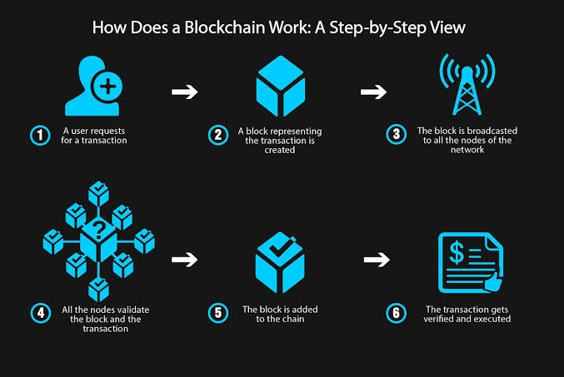

Slide 3
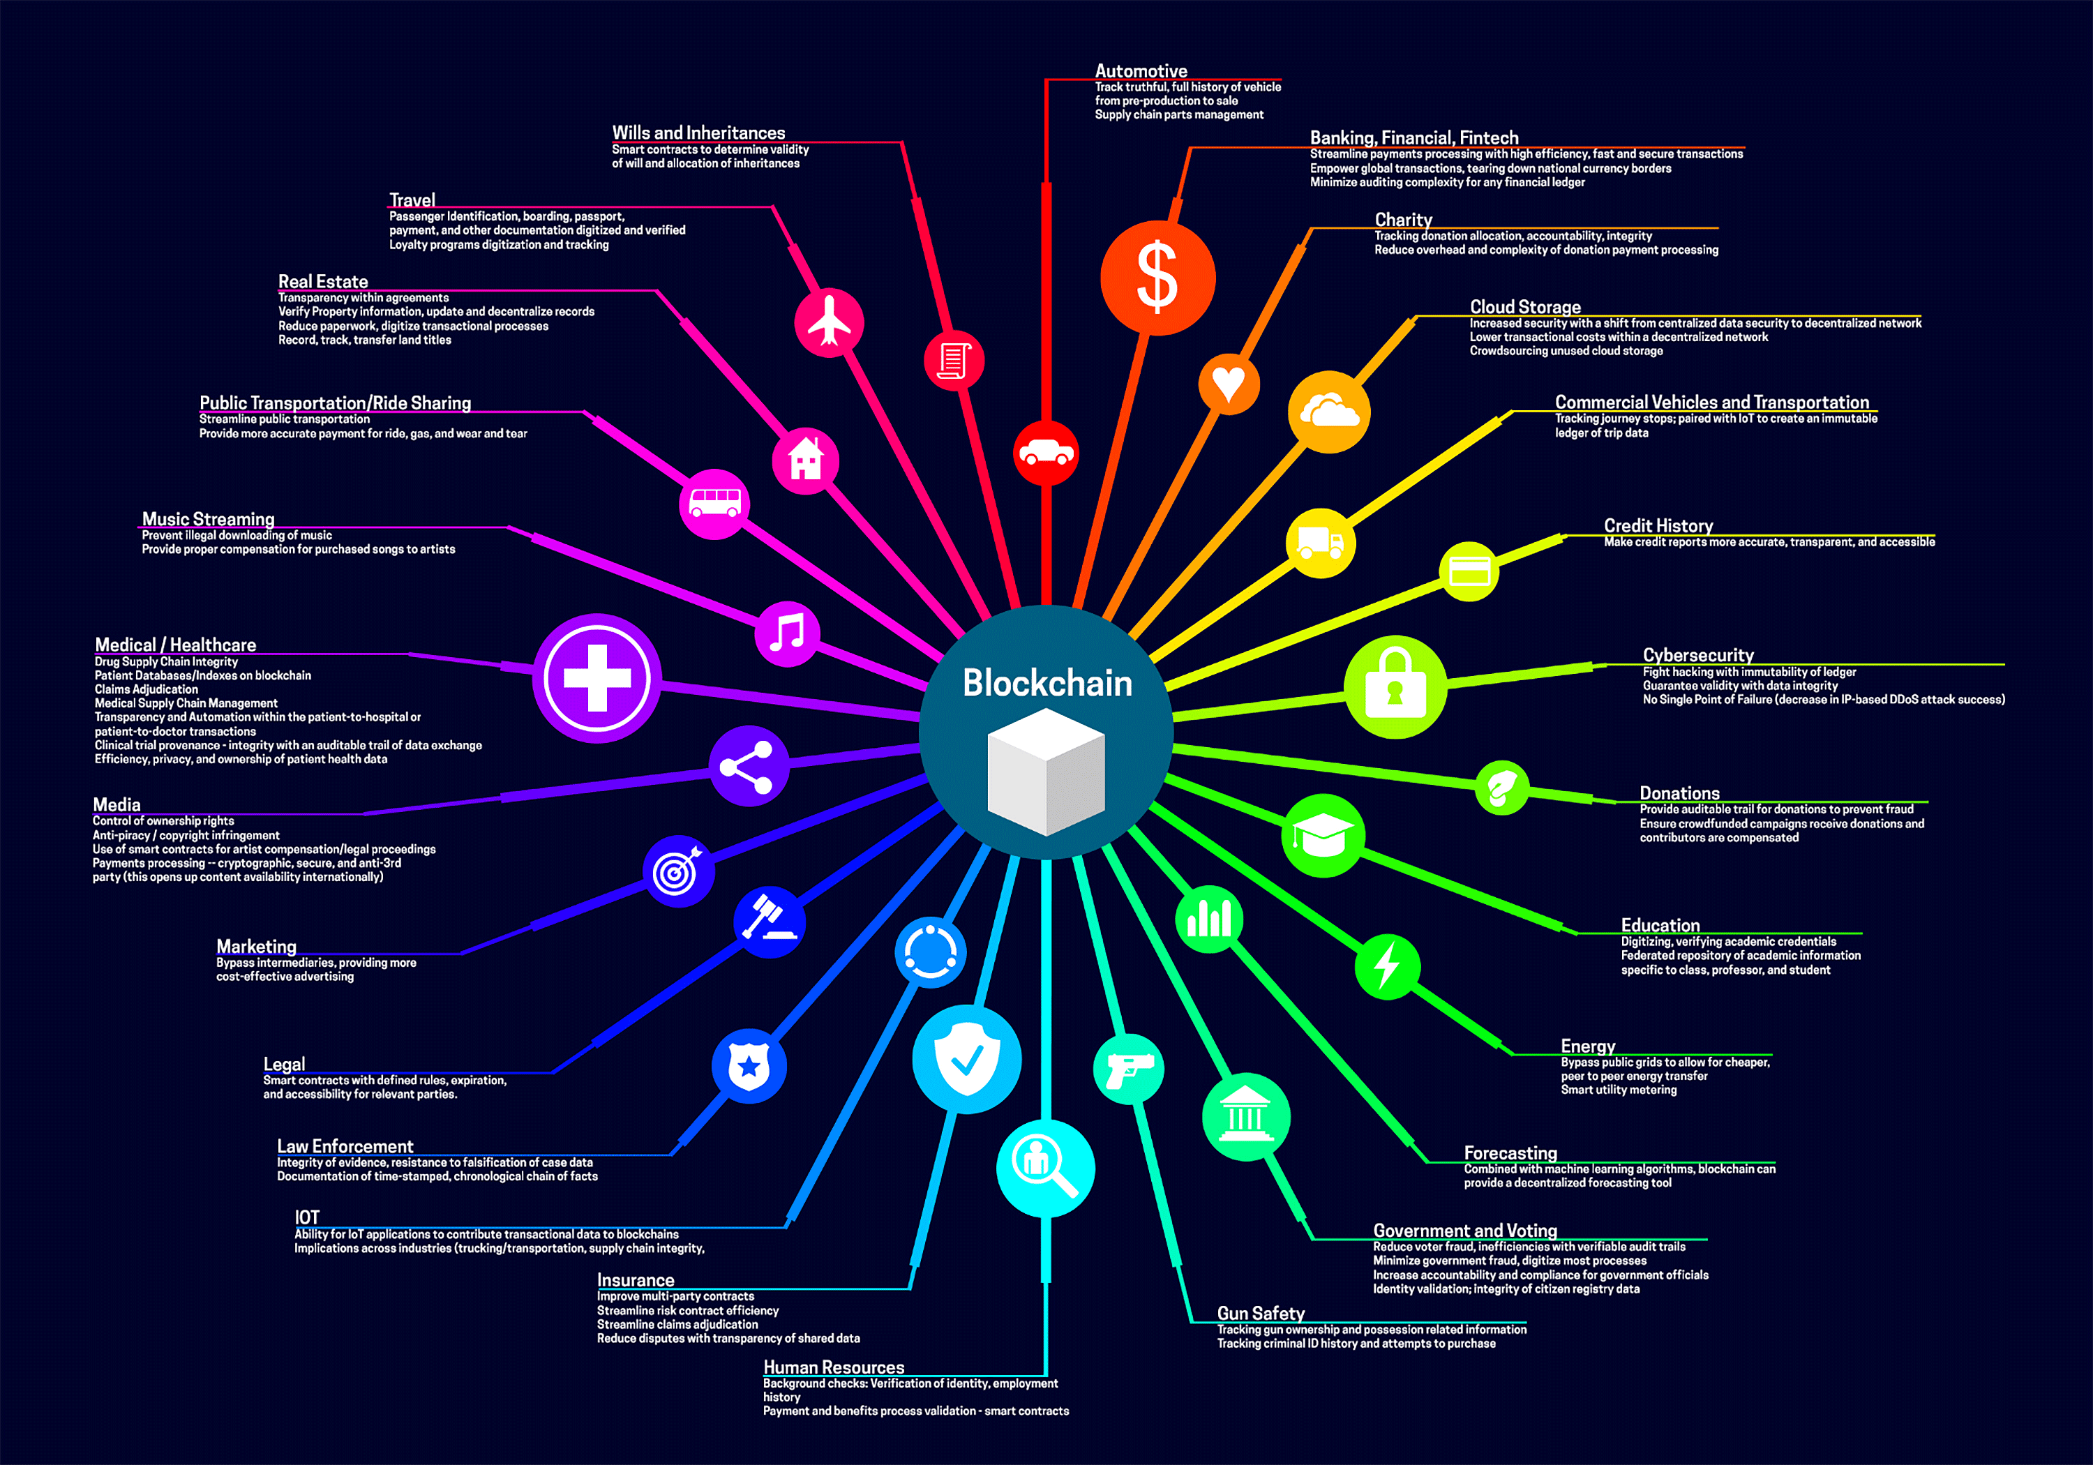

Slide 4
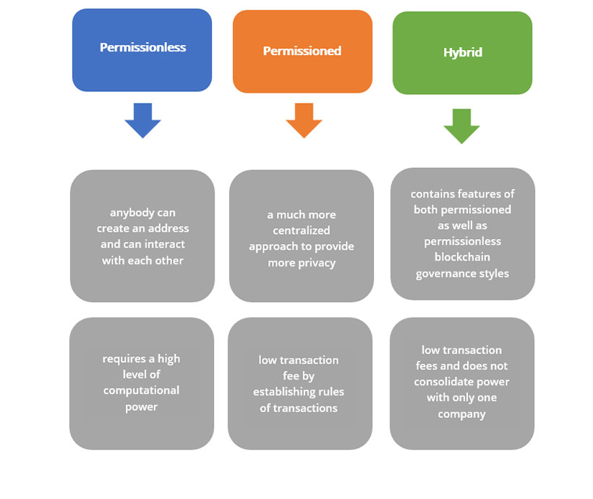

Slide 5
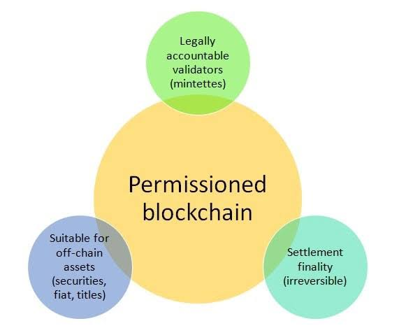

Slide 6
